Slide 1

Real Time Sudoku Solver
Aarushi Dua (18CSU002)
Abhishek Bhatia (18CSU008)
Bhavya Kalra (18CSU045)

Slide 2

HOW DID WE DO IT…
STEPS:
We take the Sudoku grid from our webcam Image.
We Extract and Detect the Digits.
Solve the puzzle and Print the solution.

Slide 3
STEP 1: Grab the Sudoku grid from Webcam Image.
Capture the video frame continuously(cv2.videoCapture).
We take the input frame and convert it to gray scale(cv2.cvtColor).
Blur the Image using Gaussian Blurring (cv2.gaussianBlur).
Apply Adaptive Thresholding (cv2.adaptiveThreshold).
We get a binary Image.
Then we Find all contours(cv2.findContours).
Extract the contour with the biggest area (cv2.contourArea).
Locate 4 corners of the contour and determine the upper left, upper right,
bottom left, bottom right corners.
If the biggest contour is a square(required), from 4 corners, we apply
cv2.wrapPerspective to get a nice and stable Sudoku Grid Image.

Slide 4
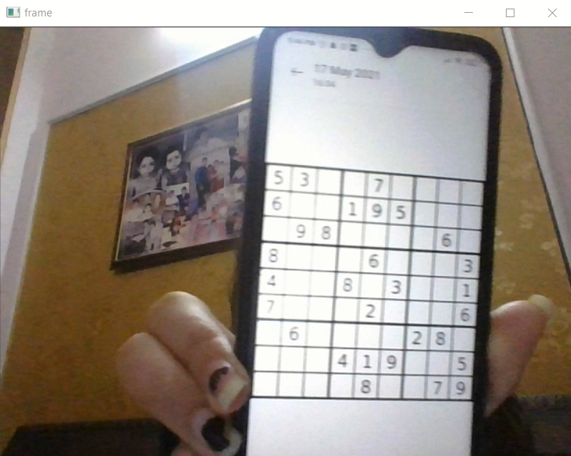
Capturing Video
Use cv2.VideoCapture() to get a video capture object for the camera.
Set up an infinite while loop and use the read() method to read the frames using the above created object.
Use cv2.imshow() method to show the frames in the video.
Breaks the loop when the user clicks a specific key.
# cap = cv2.VideoCapture(0) and feed it using
# ret, frame = cap.read()

Slide 5
Gray and Blur
We take the input frame and convert it to gray scale by using (cv2.cvtColor)
#gray = cv2.cvtColor(frame, cv2.COLOR_BGR2GRAY)
To smooth the image we have applied various blurring techniques like
2D Convolution, blur, Gaussian Blur, median, bilateral Filter
Out of which we got the best result using Gaussian Blur
#cv2.GaussianBlur(gray, (5, 5), 0)

Slide 6
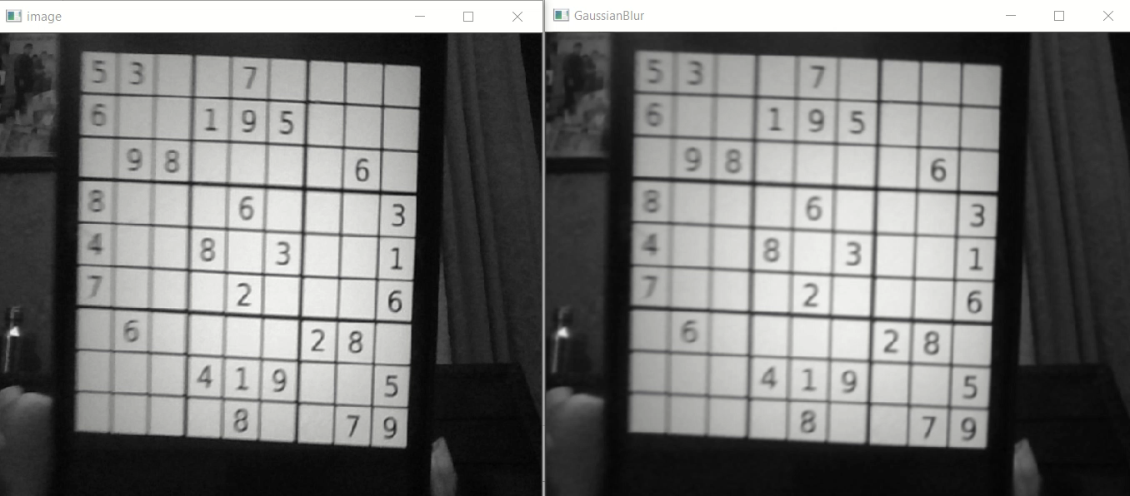

Slide 7
Applying Adaptive Thresholding
We apply various thresholding techniques on our image to get the best version of image in binary format.
We tried Global Thresholding (v = 127), Adaptive Mean Thresholding, Adaptive Gaussian Thresholding
Out of these we got the best result from adaptive Gaussian Thresholding.
#cv2.adaptiveThreshold(gray,255,cv2.ADAPTIVE_THRESH_GAUSSIAN_C, cv2.THRESH_BINARY,11,2)

Slide 8
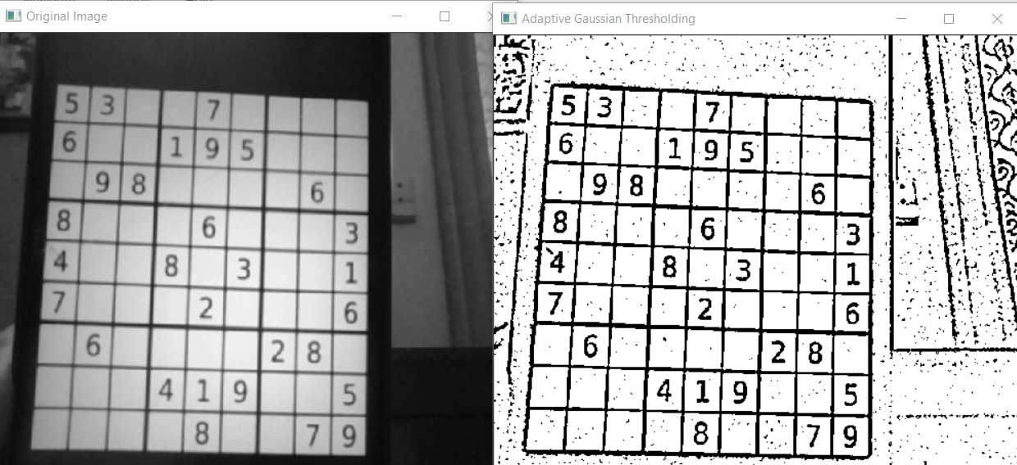

Slide 9
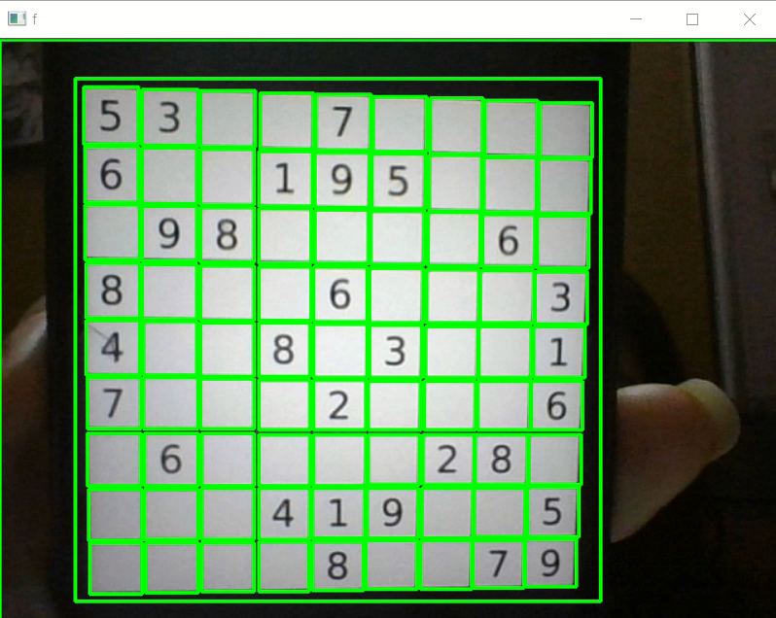
Finding Contours
For outer grid detection we have used Contours to detect our grid.
To find all the contours in the grid we used
#contours,hier = cv2.findContours(thresh,cv2.RETR_TREE,
cv2.CHAIN_APPROX_SIMPLE)

Slide 10
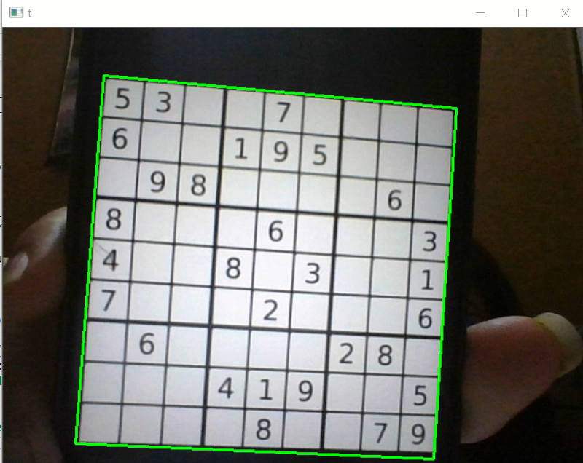
Finding Largest contour(Area)
To find the biggest contour of the Grid we used Contour Area to obtain the biggest rectangle of the grid and for more accurate grid we need to detect 4 sided grid with help of approximating the contours.
#cv2.approxPolyDP(c, 0.01 * peri, True)

Slide 11
Warping the perfect image
After getting the Boundary of our Grid using Contour, we need to obtain the top-down image of our frame with the help of cv2.getPerspectiveTransform
We calculate the perspective transform matrix and warp the perspective to grab the screen.
#cv2.getPerspectiveTransform(pts1, dst)
#cv2.warpPerspective(frame, perspective_transformed_matrix, (max_width, max_height))

Slide 12
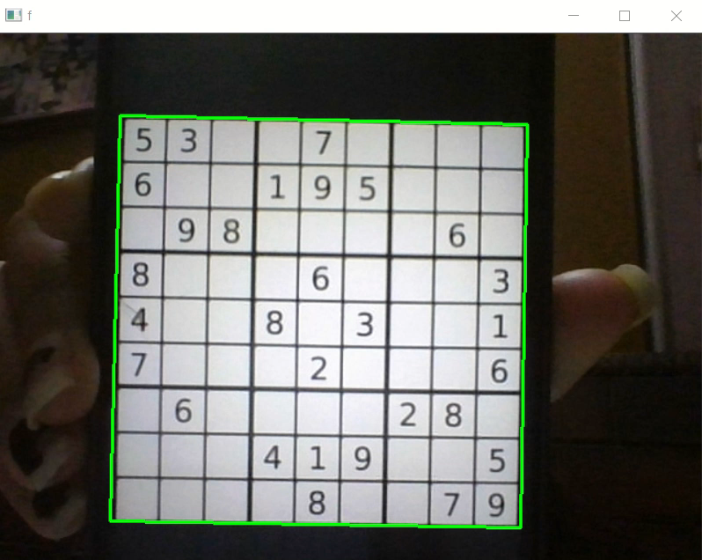
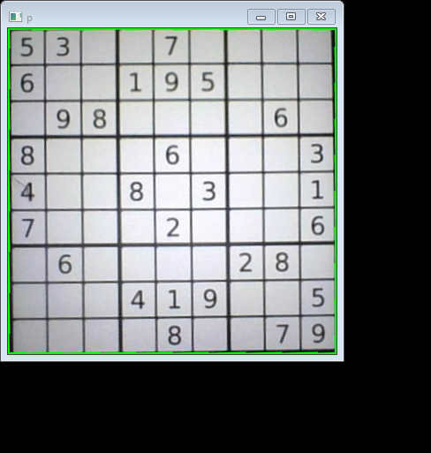

Slide 13
STEP 2: Extract and Detect Digits.
This Step will begin by Image processing and chopping Sudoku create images into 9x9 Square blocks .
So Before feeding them into for Digit Recognition we need to clean them up first .
Remove Black lines near 4 edges (if any) .
Take only the largest connected component (cv2.connectedComponentWithStats) , which should correspond to digit and turn the rest into white pixels .
We leave out any white cells
• Criteria 1: The image has too little black pixels (sum of all pixels are too big)
• Criteria 2: The image has a huge white area in the centre .
6. Finally , let's recognise those digits with the help of Python-tesseract

Slide 14
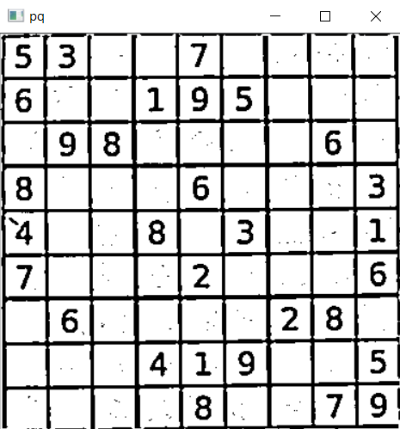
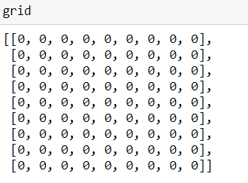
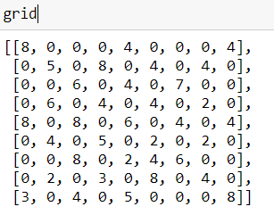
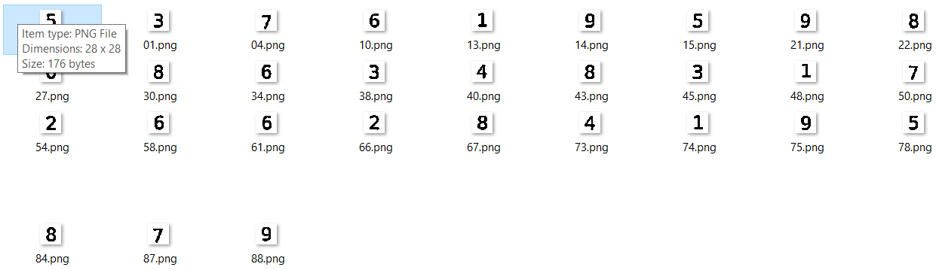
Chopped Images

Slide 15
STEP 3: Solve the puzzle and Print the solution
Firstly check whether the given grid is violating sudoku or not.
2.In the loop, start with box with least possible choice and then fill it with remaining option.
3.Before assigning a number, check whether it is safe to assign. Check that the same number is not present in the current row, current column and current 3X3 subgrid. After checking for safety, assign the number, and recursively check whether this assignment leads to a solution or not. If the assignment doesn’t lead to a solution, then try the next number for the current empty cell. Loop till all grid becomes non zero

Slide 16
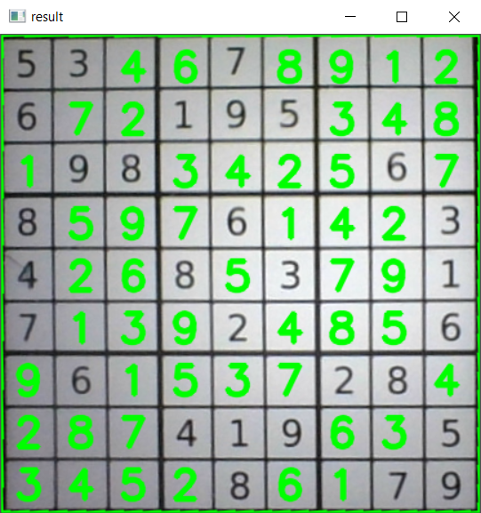
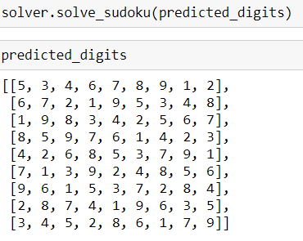
FINAL RESULT

Slide 17
THANK YOU

